Slide 1
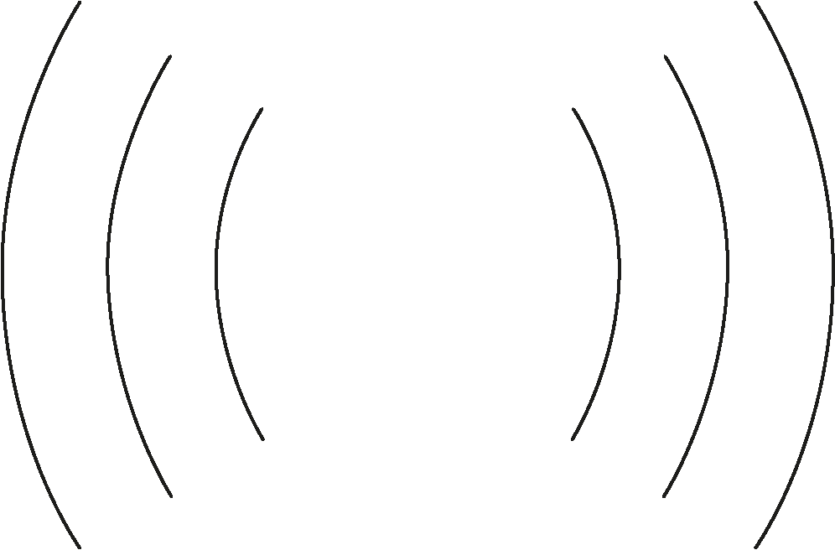
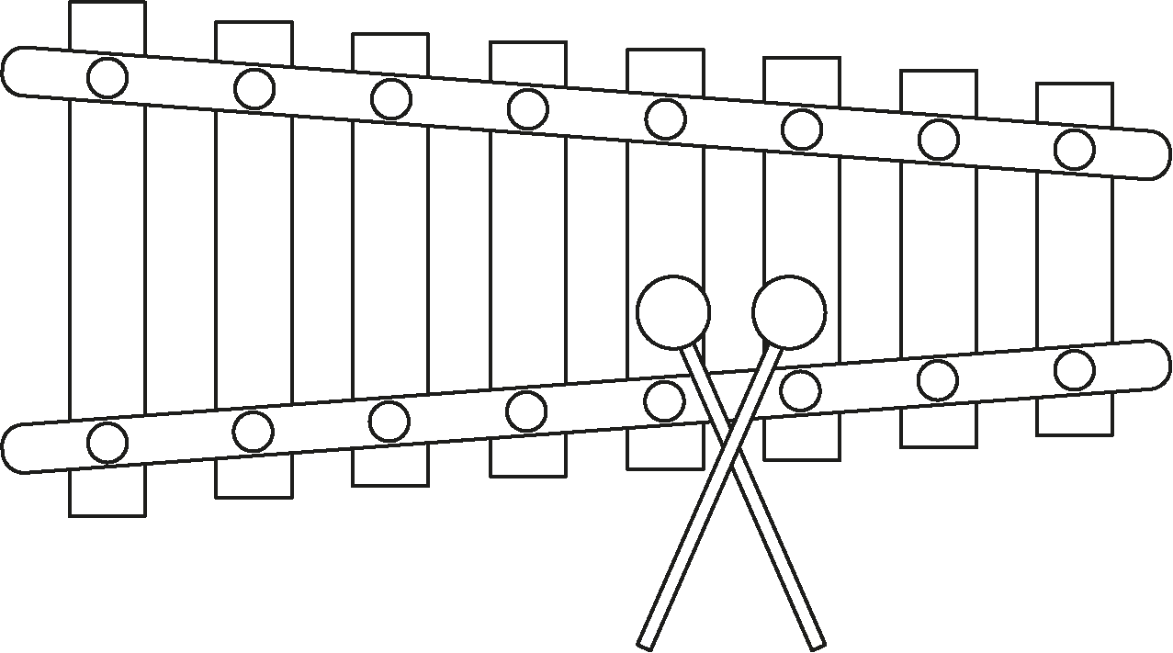
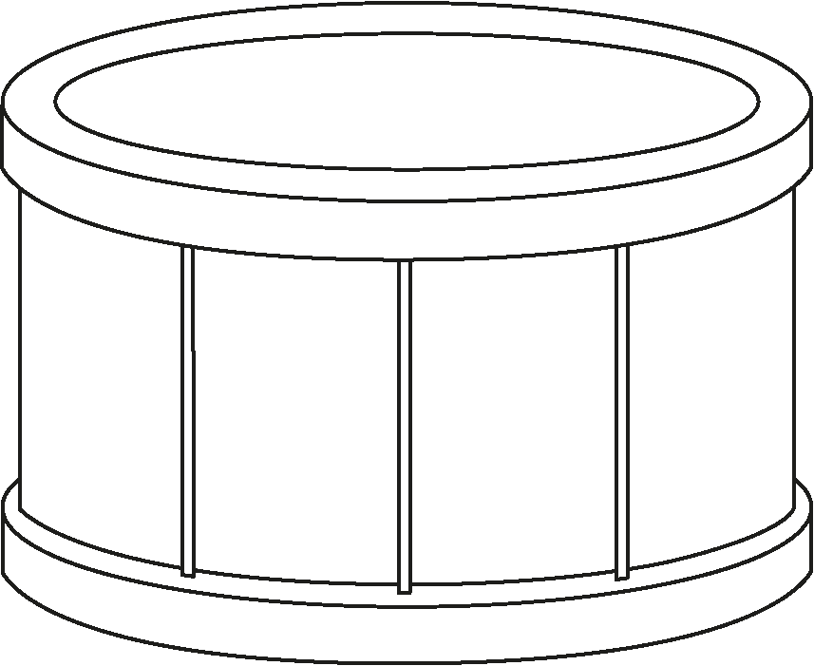
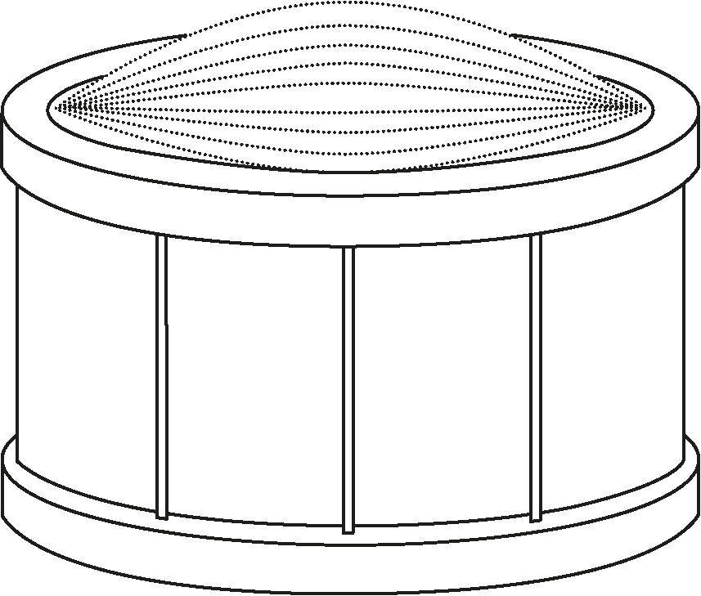
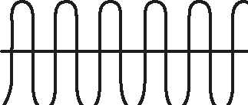
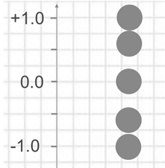
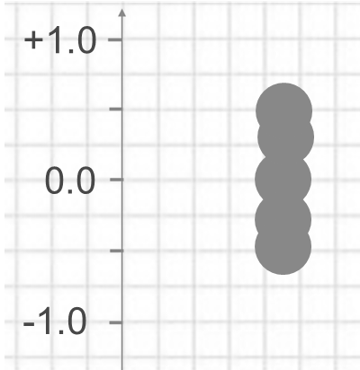
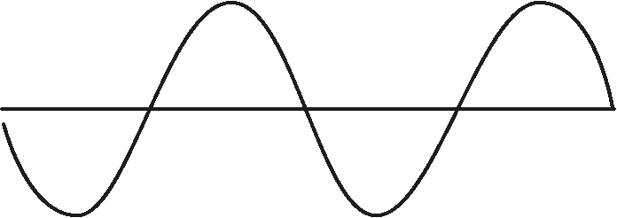
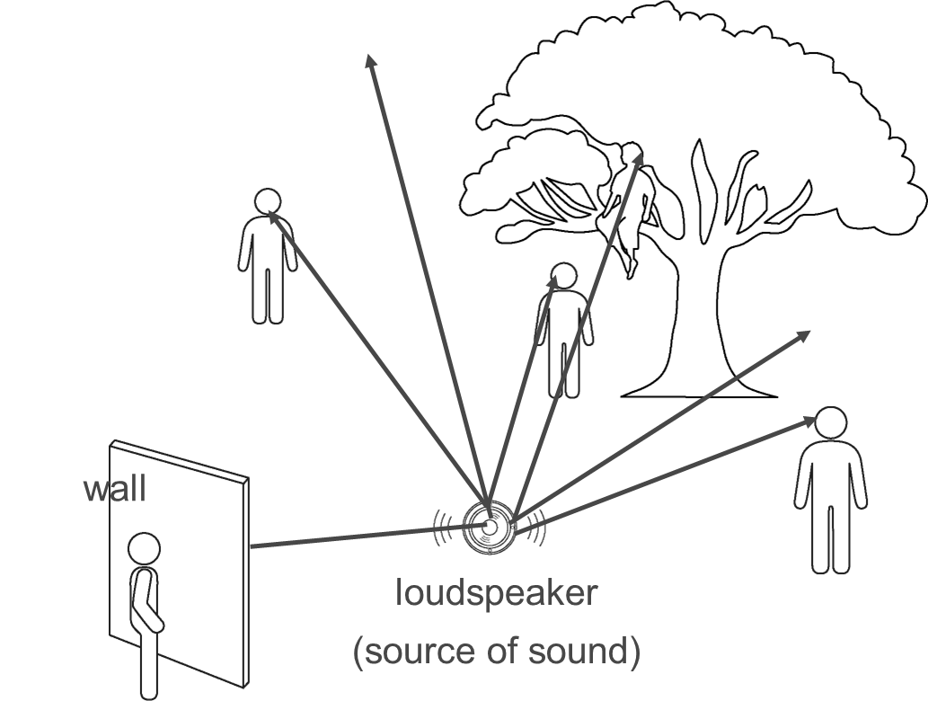

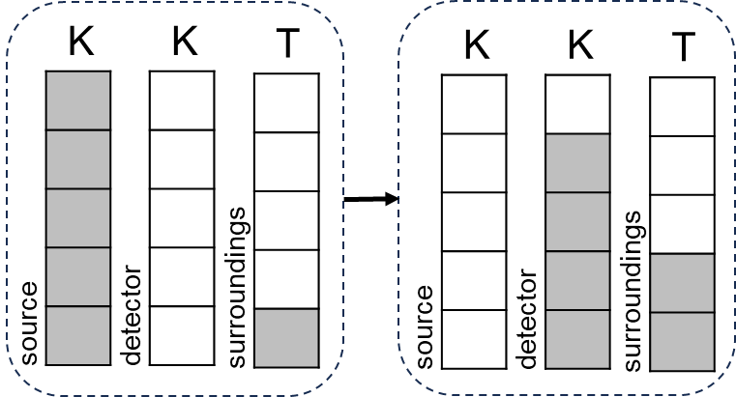


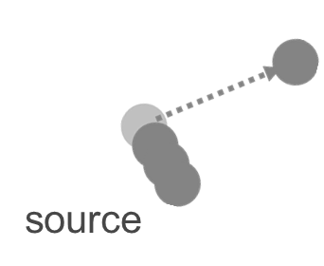


Sound and light
Describing sound
Sources of sound
Volume
Pitch
No sound | Force exerted | Vibrating matter
High (loud)
Low (quiet)
High-pitched
fast
large
small
Low-pitched
slow
amplitude
frequency
Vibrations travel through matter
Energy transfer
Travel in all directions from a source.
Can be observed by detectors placed at a distance.
If blocked, a shadow region occurs.
Fastest in solids, slowest in gases.
Gas ✓
Liquid ✓
Solid ✓
Vacuum ✗
As vibrations travel, the energy store of the source decreases.
The energy store of the matter increases.
The kinetic store of any detector increases.
By the mechanical pathway.
Radiation
transmission
Radiation
‘strikes’ matter
Energy transfer
absorption
reflection
particles
waves
The thermal store of the surroundings also increases.
Examples of radiation by waves: sound and light.
Science | 7.06: Sound and light | Knowledge Organiser

Slide 2

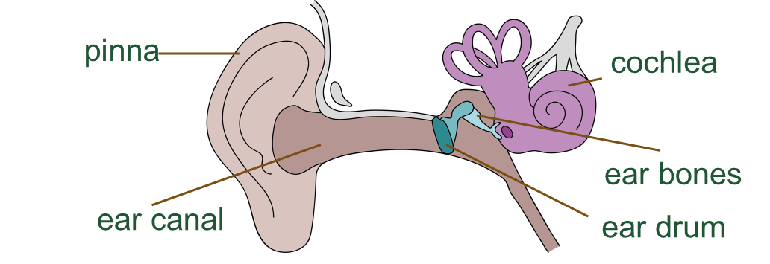
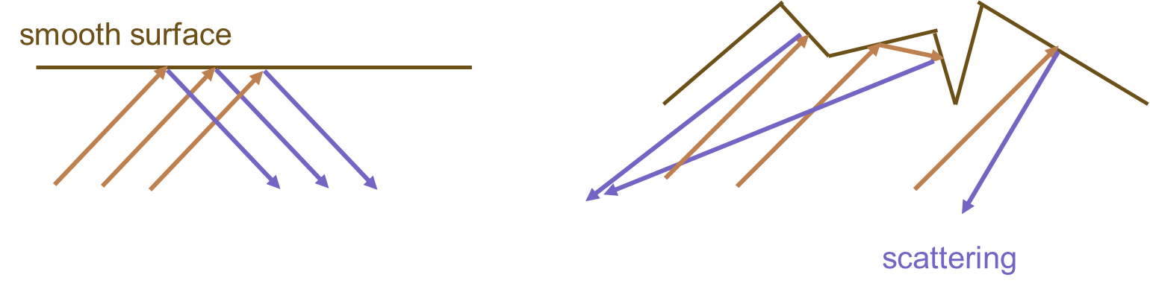
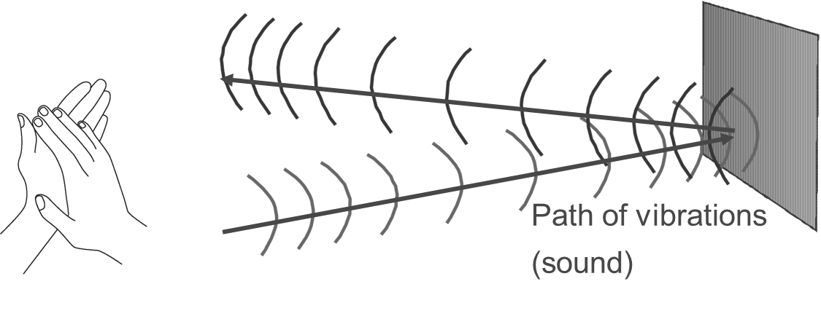
Sound and light
Vibrations get less with distance
Hearing
The ear
Energy spreads out among more particles.
Each particle absorbs some energy, not passing it all on.
If all energy is absorbed, a shadow region occurs.
best absorbers
softer
thicker
Sound in the ear
The function:
  transfer energy to the nervous system, as much as possible
  from the vibrations in the air
  to the inner ear,
  so that the brain can perceive and interpret it.
  Energy transfer from the tiny hairs in the cochlea to the nerves is by the electrical pathway.
smooth surface
rough surface
Reflections
Surfaces
Smooth surfaces can build noise.
Rough surfaces scatter sound so that it spreads out and quietens.
Noise can be made worse by many reflections interacting, and better by using rough surfaces.
scattering
Differences in hearing
The audible range of human hearing is from about 20 Hz to 20 000 Hz.
Above this is ultrasound and below this is infrasound.
Different animals have different ranges of hearing.
Exposure to loud sounds and ageing can contribute to hearing differences, e.g. deafness.
Echoes
A reflected sound is an echo.
Some animals use echoes.
Science | 7.06: Sound and light | Knowledge Organiser

Slide 3
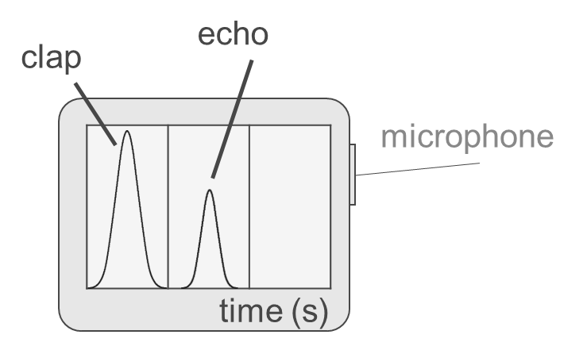
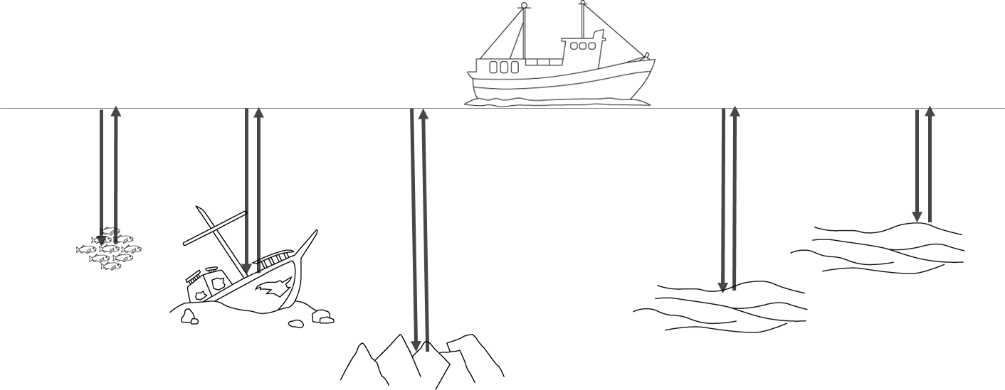
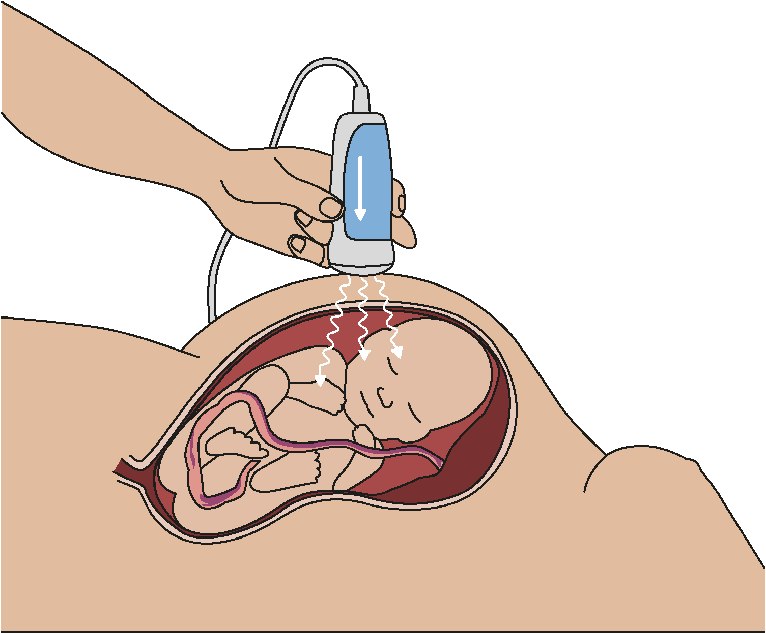
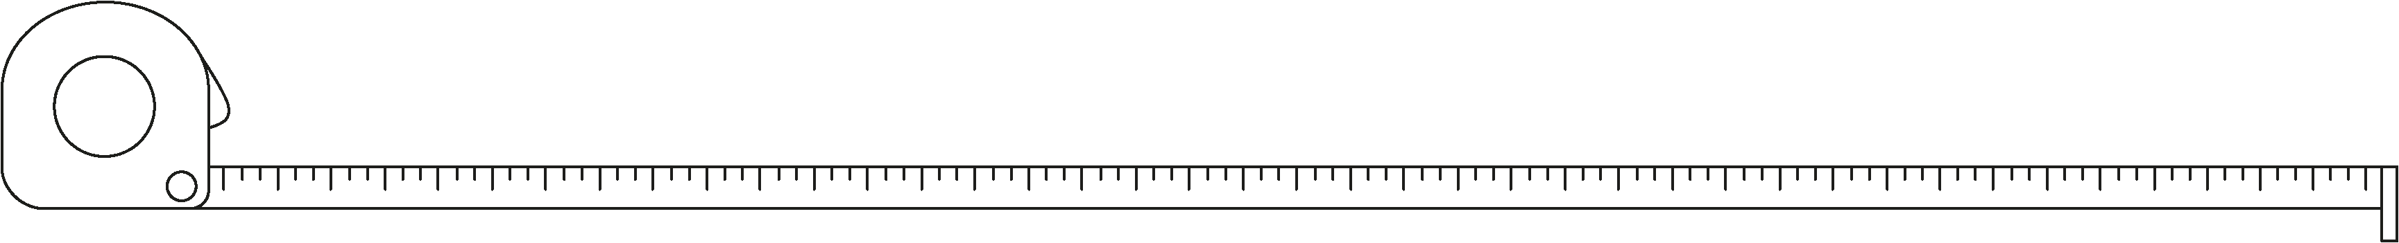
Sound and light
Using technology to improve data quality
Observing by measurement
Measuring short times
Digital clock reduces systematic error (no scale).
Datalogging equipment:
  reduces difficulty observing quiet sounds e.g. echoes
  reduces difficulty judging when sound arrives (measures directly)
  reduces reflex action delays
  allows ‘zoom in’ on time scale.
Quantities: and their units
Base quantities: length (m), mass (kg), time (s), temperature (K).
Derived quantities include force (N), frequency (Hz), loudness (dB).
Measuring instruments
Include rulers, balances, clocks and thermometers.
Measuring tapes are used to measure distances longer than a few metres.
Using scientific knowledge
Echolocation
Finding an object
Acoustic imaging
Deep in the sea
Inside living organisms (foetal scan)
Inside solid objects
Unit prefixes
Standard prefixes change a number by multiples of 1 000, e.g. one kilometre is equal to 1 000 metres.
The prefix milli- uses a multiple of 0.001, it means one thousandth:
one millisecond is one thousandth of a second (1 ms is easier to use than 0.001 s).
A non-standard but common prefix is centi-, to mean one hundredth.
one centimetre is one hundredth of one metre (1 cm is easier to use than 0.001 m).
We have more information, of better quality, with much less risk.
Hearing technology examples
Hearing aids
Hearing implants
Hearing loops
Reduce the chance of hearing damage by wearing ear protection and reducing volume of sounds.
Science | 7.06: Sound and light | Knowledge Organiser

